Slide 1

Design and Testing II Acme - Madrugá
Ángel Delgado Luna
Problem 2 - Finder

Slide 2
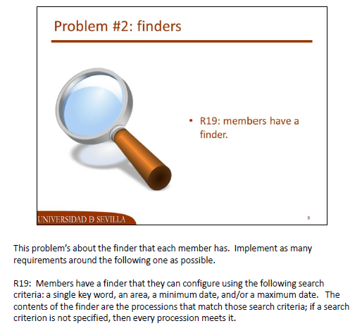
What do we have to talk about?

Slide 3
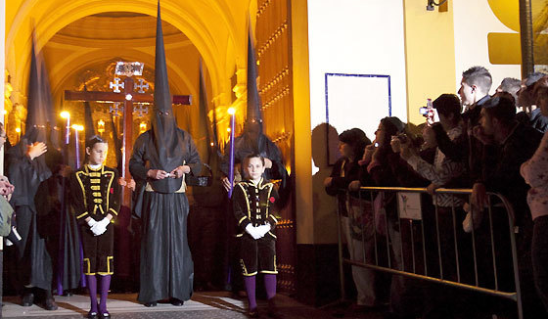
Ok. Let´s go ahead
Models
Conceptual
Domain
Java
Repository
Service
Option 1
Option 2
Chosen solution
JUnit4 Tests
Controllers
Views
Custom Tags

Slide 4


First of all…

Slide 5


Models

Slide 6
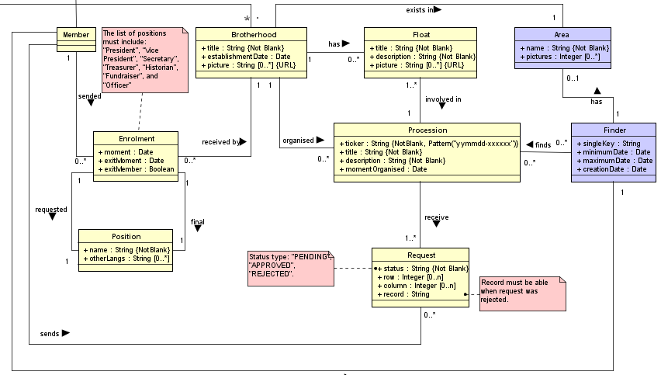
Models – Conceptual Model

Slide 7
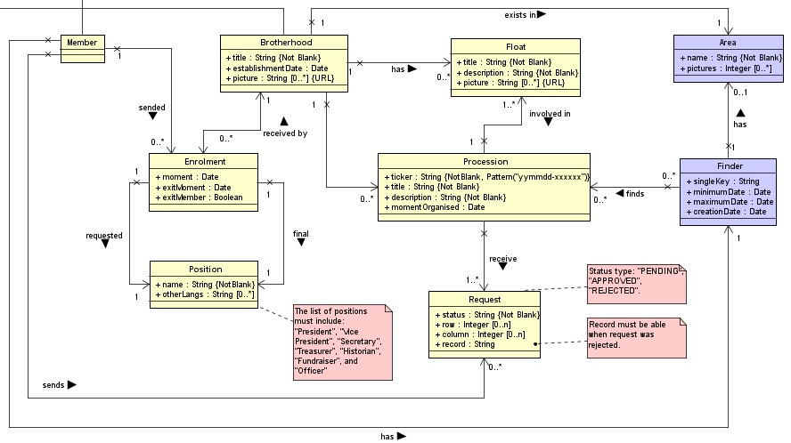
Models – Domain Model

Slide 8
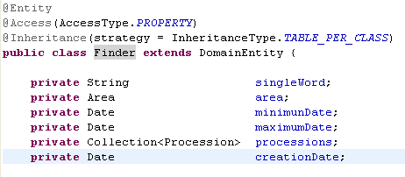
Models – Java Implementation

Slide 9

Repository

Slide 10
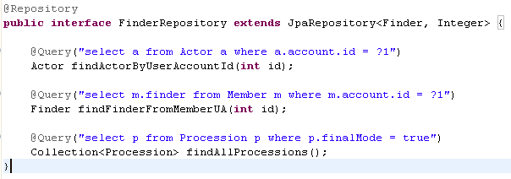
Repository - Implementation

Slide 11
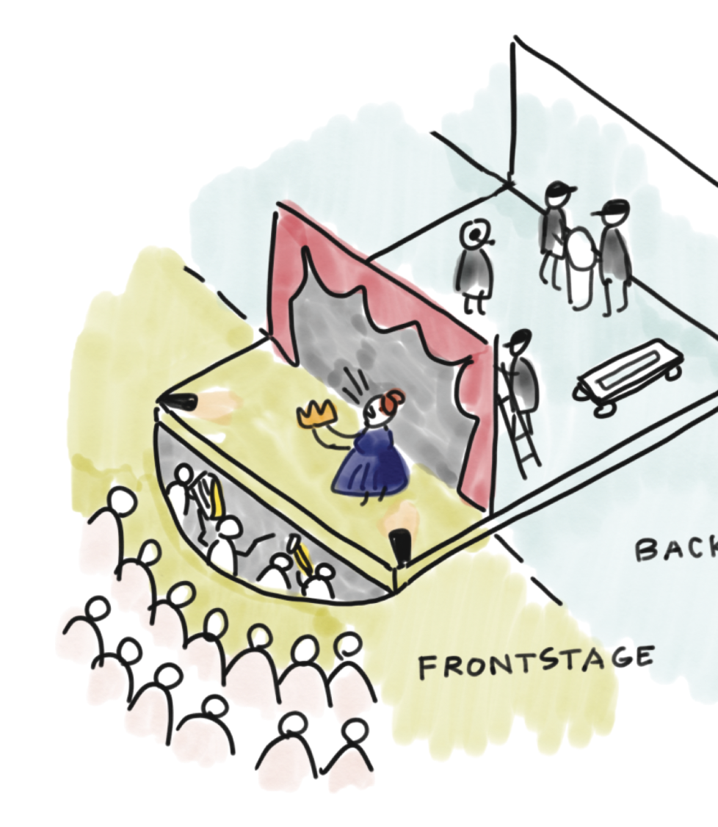
Services

Slide 12


Options
Using a Query whose parameters are discriminated according to users request
Retaining a Collection

Slide 13
Option 1
Context
We extract all the elements from database
We operate with the collection retaining those elements whose criteria adapts to user request
Using a Query whose parameters are discriminated according to users request
Retaining a Collection
Pros
We manage every object directly and let us to check individually in case of.
No Indexes are necessary
Against
It´s no necessary to take the whole data from Database. It doesn´t prevent from OverFlow.
Unnecesary data can exists on the collection.

Slide 14
Option 2
Context
We exactly extract the objects that we want.
User is given the choice to select any of the possible ítems.
Using a Query whose parameters are discriminated according to users request
Retaining a Collection
Pros
We just take the data requested.
We exactly discriminated parameters to be used in a string, non in a collection as shown in Option 1.
Cons
Too cost because of String and Date parameters.
We have to make the query by hand.

Slide 15

Who is the winner?

Slide 16
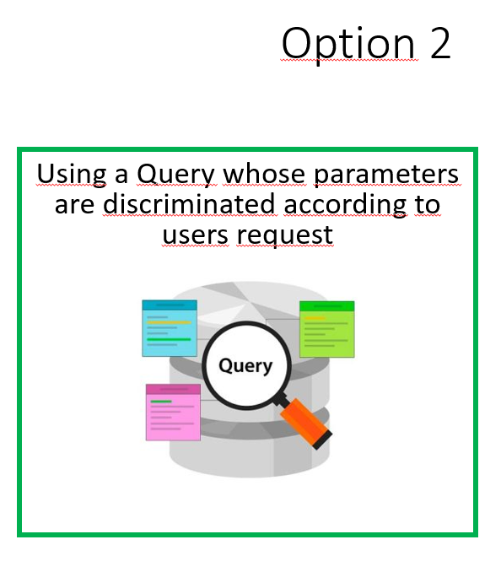

Slide 17
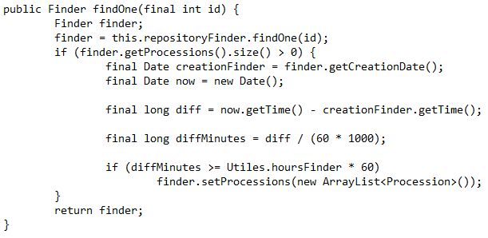
Option 2 – Implementation - Service
Req. 23

Slide 18
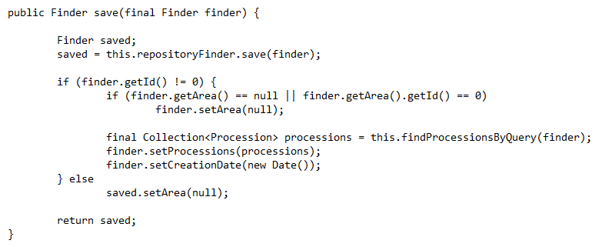
Option 2 – Implementation - Service

Slide 19

Option 2 – Implementation - Service
private Collection<Procession> findProcessionsByQuery(final Finder finder) {
StringBuilder builder;
builder = new StringBuilder();
builder.append("select p from Brotherhood b join b.processions p where p.finalMode = true AND");
System.out.println("entro query 1");
final EntityManagerFactory emFactory = Persistence.createEntityManagerFactory(DatabaseConfig.PersistenceUnit);
final EntityManager entityManager = emFactory.createEntityManager();
List<Procession> result = queryTQuery.getResultList();
System.out.println(result.size());
if (result.size() > Utiles.resultsFinder)
result = result.subList(0, Utiles.resultsFinder);
if (result.size() < 1)
result = new ArrayList<Procession>(this.repositoryFinder.findAllProcessions());
Req. 19 y 24

Slide 20
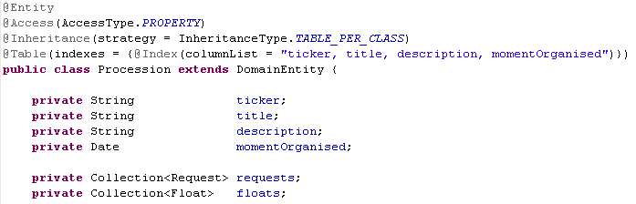
Option 2 – Model - Indexes

Slide 21

JUnit 4 - Testing

Slide 22
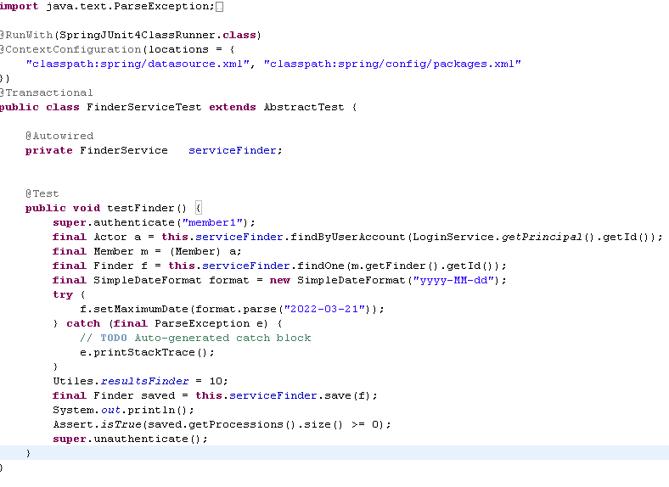
Methods

Slide 23
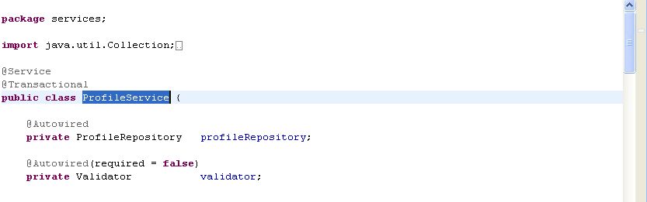
Problem found when applying JUnit4 Testing

Slide 24
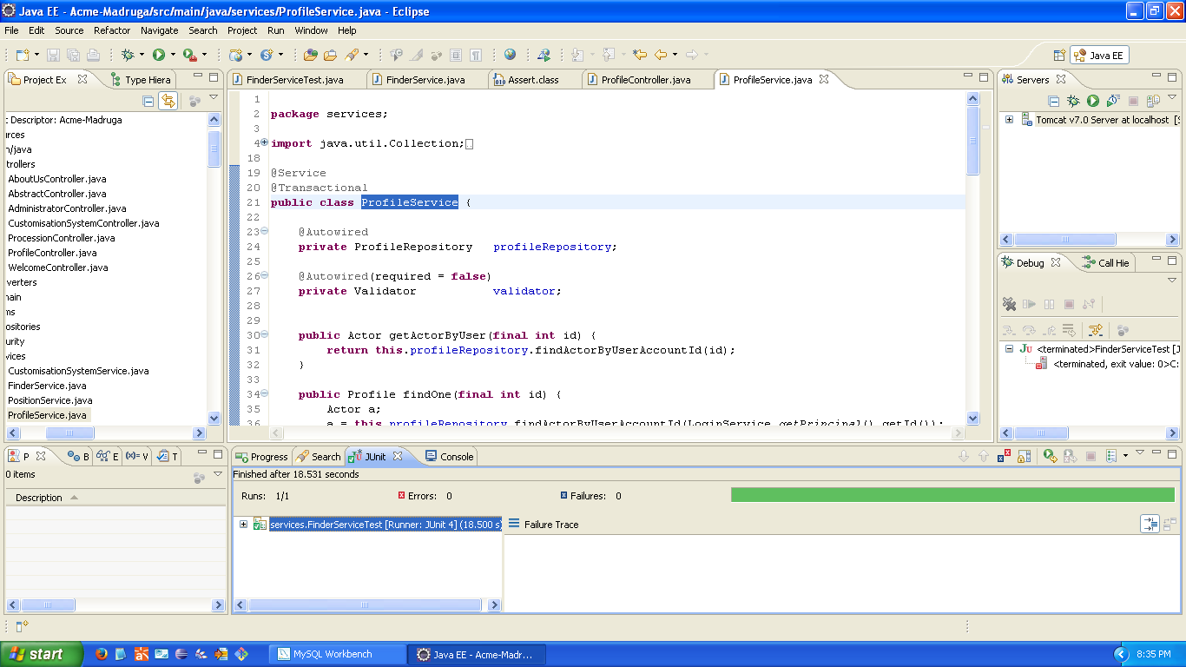

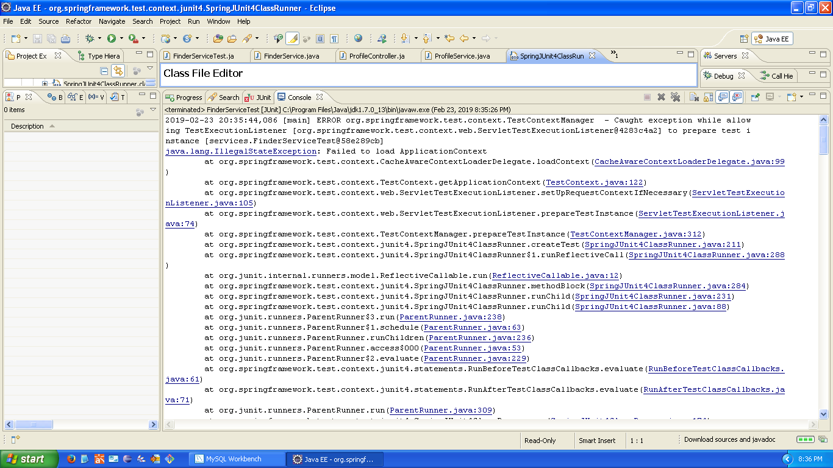
Differences

Slide 25

Controllers

Slide 26

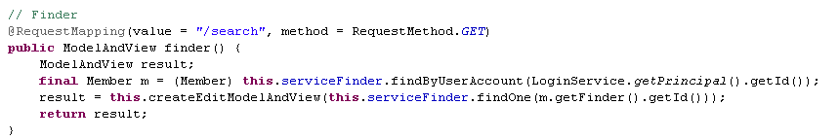

Method 1

Slide 27
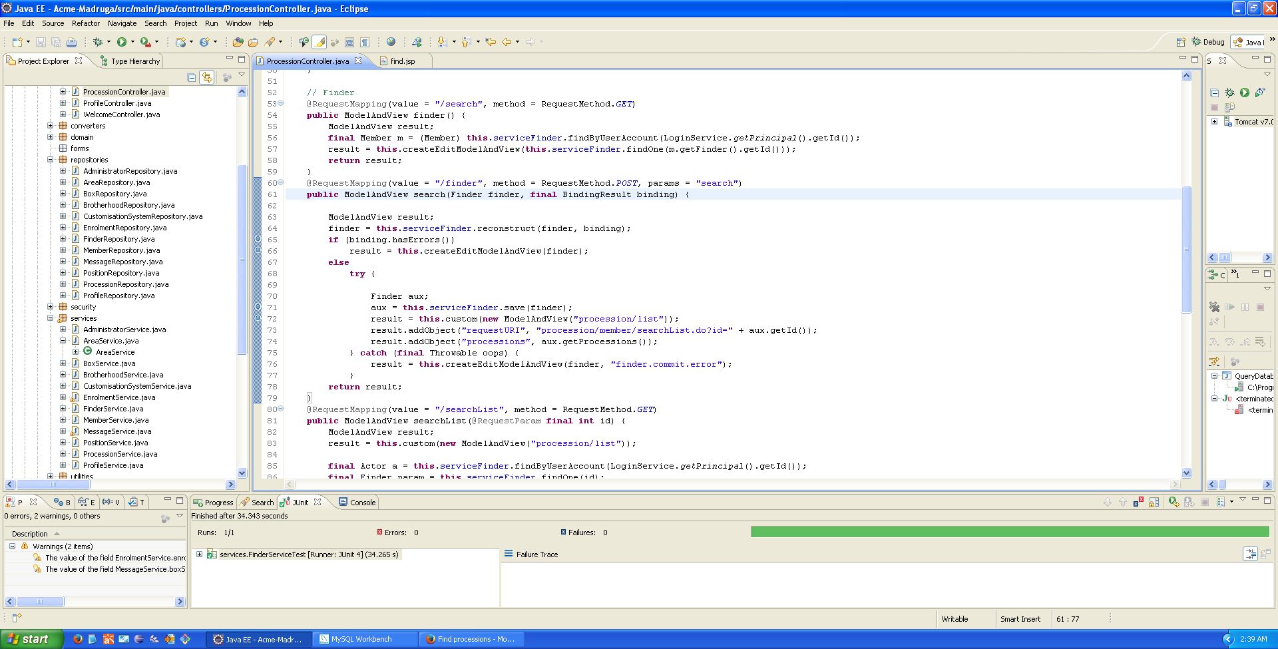
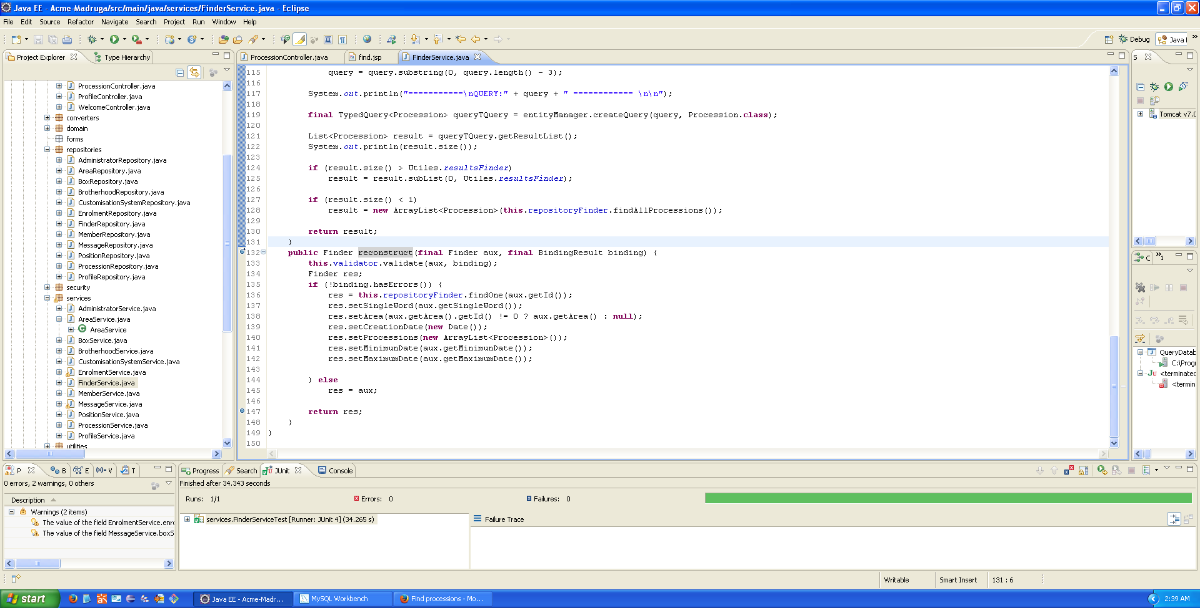

Method 2

Slide 28
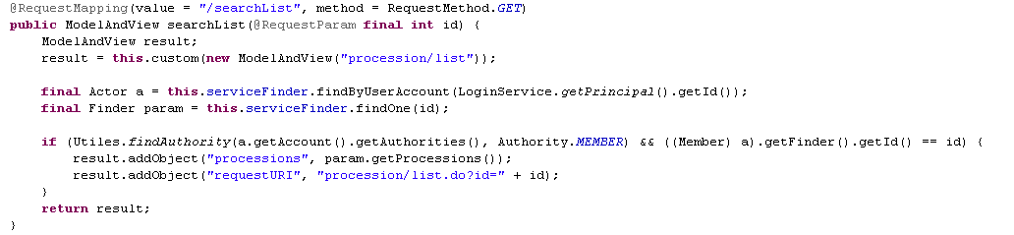
Method 3

Slide 29

Views

Slide 30
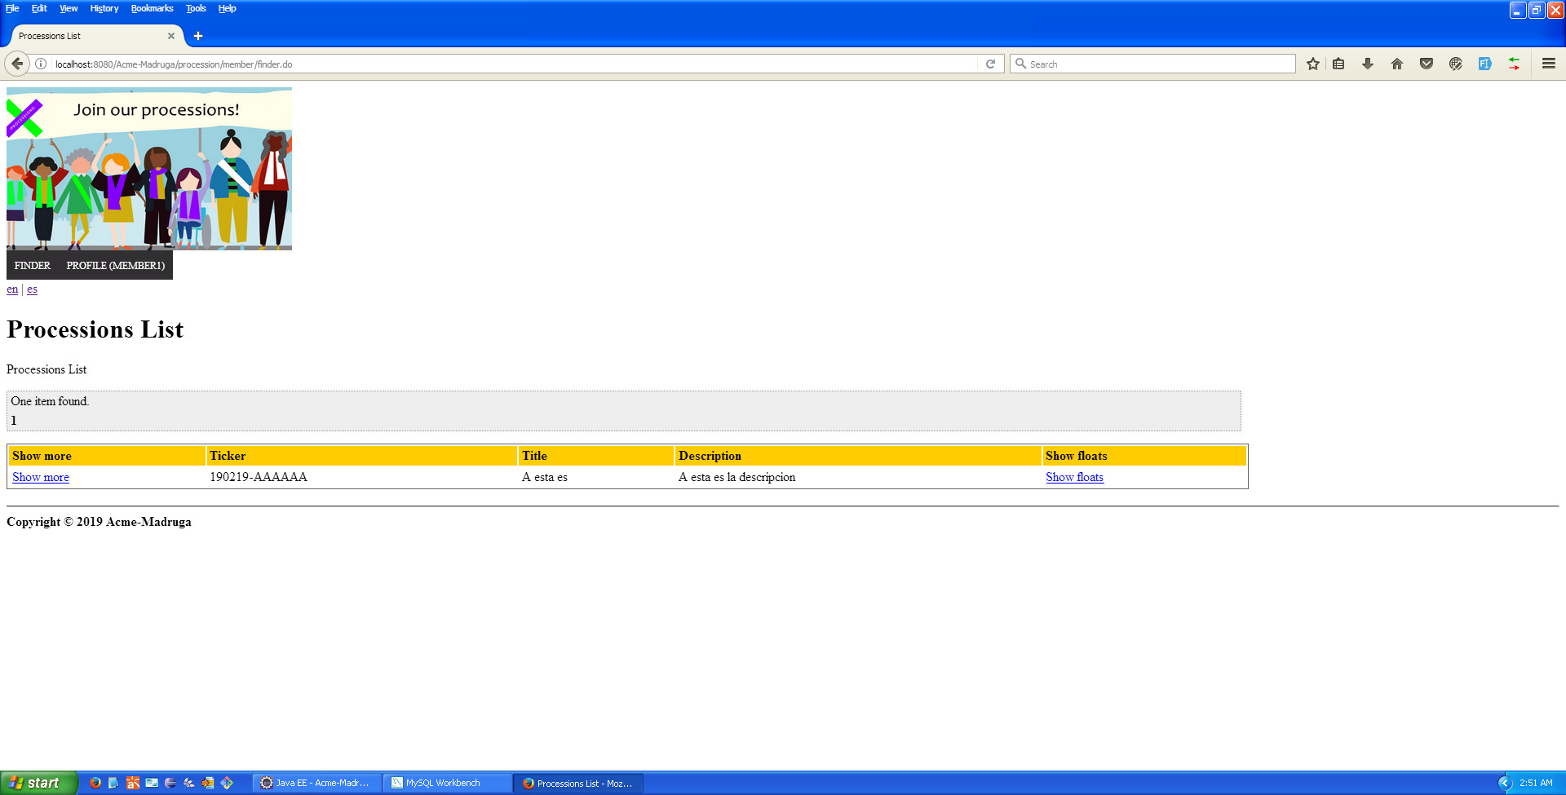
List

Slide 31
Edit
<form:form modelAttribute="finder" action=“${requestURI}">
<acme:textbox code="finder.singleKey" path="singleWord" />
<!-- Find all areas -->
<acme:select items="${areas}" itemLabel="name" code="finder.area" path="area"/>
<acme:date code="finder.minDate" path="minimunDate" id="minDate" />
<acme:date code="finder.maxDate" path="maximumDate" id="maxDate" />
<acme:submit name="save" code="finder.save"/>
<a href="fixuptask/handyworker/searchList.do?id=${finder.id}"><spring:message
code="finder.previous" /></a>
</form:form>

Slide 32
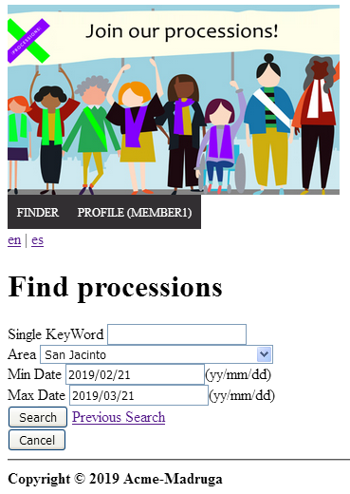
Edit - View

Slide 33
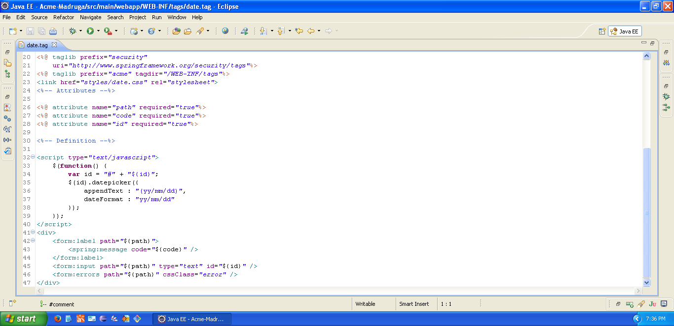
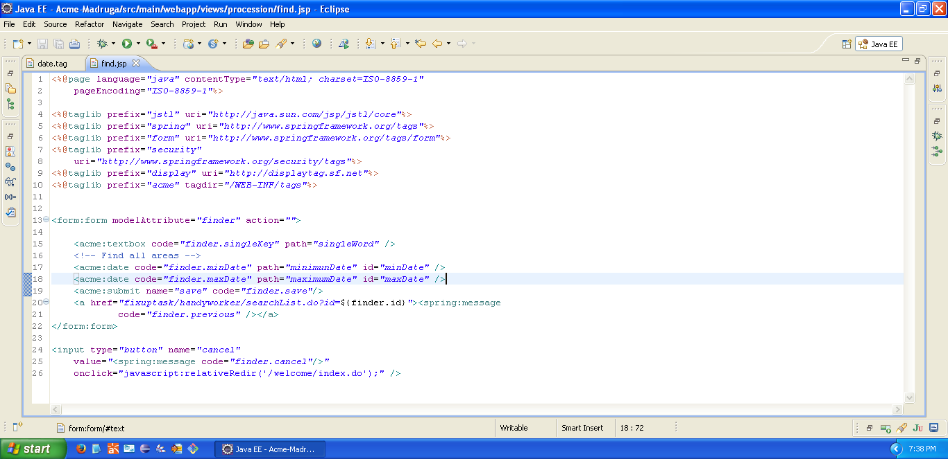
Custom Tags Date

Slide 34
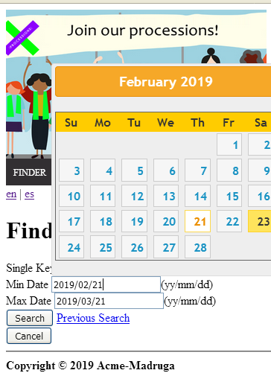
Custom Tags - Date

Slide 35
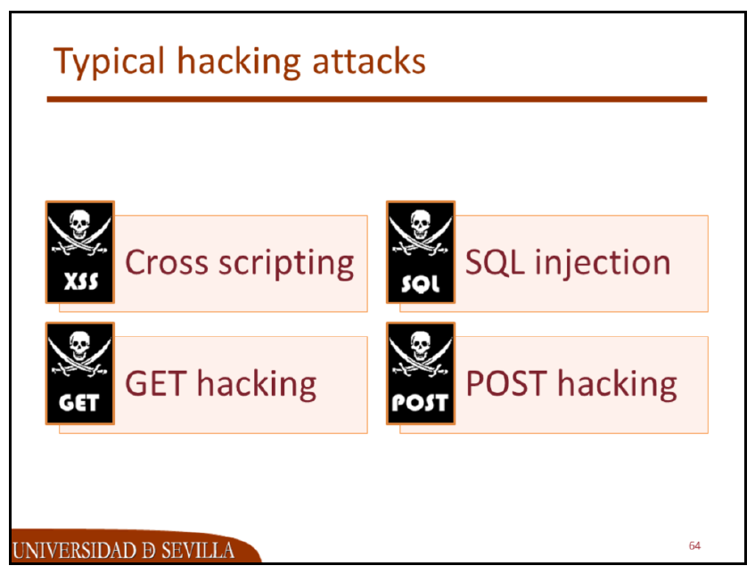


Preventing from Hacking actions

Slide 36

Thanks for your attention Questions?

